Slide 1

Movie Recommendation platform “MuseMovie”
ORIE 5741: Haoxuan Huang, Xiaoyue Chen, Yining Zhao

Slide 2
Agenda
Background & Goal
Data
Modeling
Conclusion
Future Plan

Slide 3
Background & Goal
Background
Cold-start problem for the majority of movie platforms
Only detect preferred genre, no specific movie preference is predicted
Goal
MuseMovie: Recommend personalized movie to users once they have viewing history and keep updating
Develop a machine learning model based on other users’ ratings and the movie genres

Slide 4
Data Description
Rating
user ID, movie ID, and the movie ratings (from 0.5 to 5.0) given by users
Contains about 160,000 different users, about 60,000 movies, and about 25M movie ratings
Genome_score
movie ID, tag ID, and the tag’s relevance of the movie, which are calculated using a machine learning algorithm
Contains about 13,000 movies, and each movies has 1128 tags relevance score
Due to computing resource constraints, we create a small dataset with 1000 movie and 100 users (about 5000 records)

Slide 5


Data Preprocessing
Movie Tag
Tag Relevance
Movie ID
Movie Tag
Movie Ratings
User Tag relevance
User ID
Movie ID
User ID

Slide 6
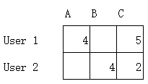
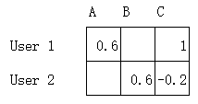
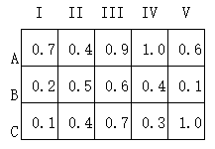


Data Preprocessing
Scale
=

Slide 7
Data Preprocessing
Movie Tag
Tag Relevance
Movie Tag
User Tag relevance
User ID
“concatenate”
Movie ID

Slide 8
Data Preprocessing
Dataset
Train (70%)
Test (30%)
Random choose input data and make the prediction

Slide 9
Modeling
PCA --> reduce the dimensionality of a dataset from (3500, 2256) to (3500, 200)
Random Forests --> apply bagging on regression trees to predict the ratings from the users to a specific movie
XGBoost --> apply boosting on regression trees

Slide 10
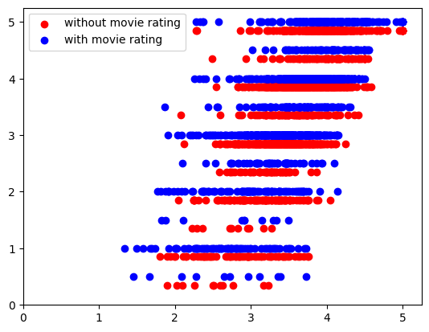
Modeling – Random Forest
What if the movie itself is bad rather than that the user does not like the movies in such tag?
--> Add overall movie ratings by other users to the model to be neutral
Real
ratings
Predicted ratings

Slide 11
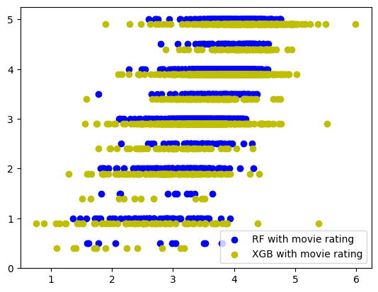
Modeling – XGBoost
Random Forest perform better than XGBoost.
The predicted results from XGBoost spread out.

Slide 12
Conclusion
By our model, we would recommend the movies ratings above 4.5 to users
Apply Random Forest to give high rating prediction is aligned to the real rating of users

Slide 13
Future Plan
Increase data size
Fine-tune the tag relevance
Try more machine learning model
Hyperparameter tuning

Slide 14
Thank you!
Haoxuan Huang
Xiaoyue Chen
Yining Zhao

